Slide 1
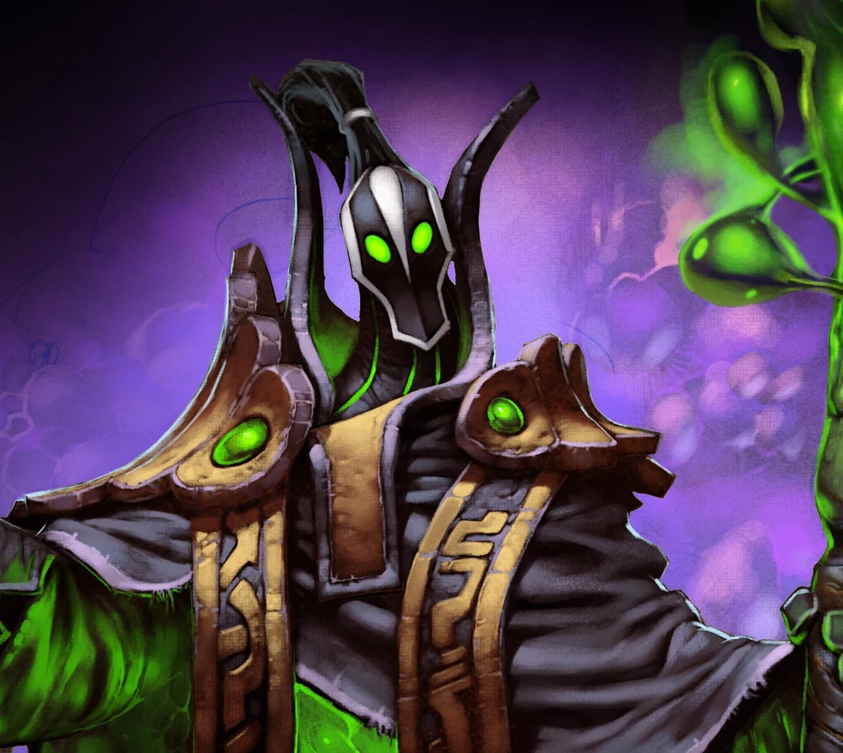

Rubick the Grand Magus

Slide 2
Magic in Dotaverse
Magic is Knowledge
Takes long time to learn anything related to magic
It can take a lifetime to create your own spell
Normal spellcasters might know one spell while more prestige ones know up to 3
Only entities like gods know more than 4
Strongest Wizards are called Magus

Slide 3
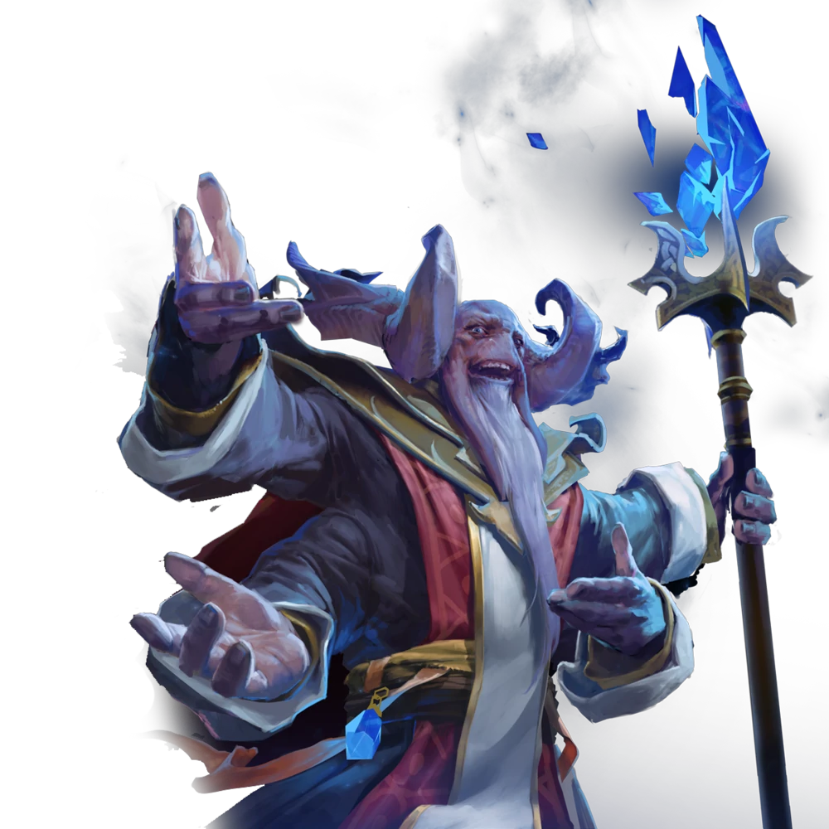
Aghanim

Slide 4
Aghanim
Strongest wizard known in Dotaverse
Demigod status
Learned to alter Time and space itself
Only things left behind:
- His staff
- His Son Rubick

Slide 5
Aghanim's Scepter
Power to alter Reality and History
Whoever holds it thinks it is theirs and that it was meant to be held by them
Every culture has a different name and History for it
Changes form to fit the person that holds it

Slide 6
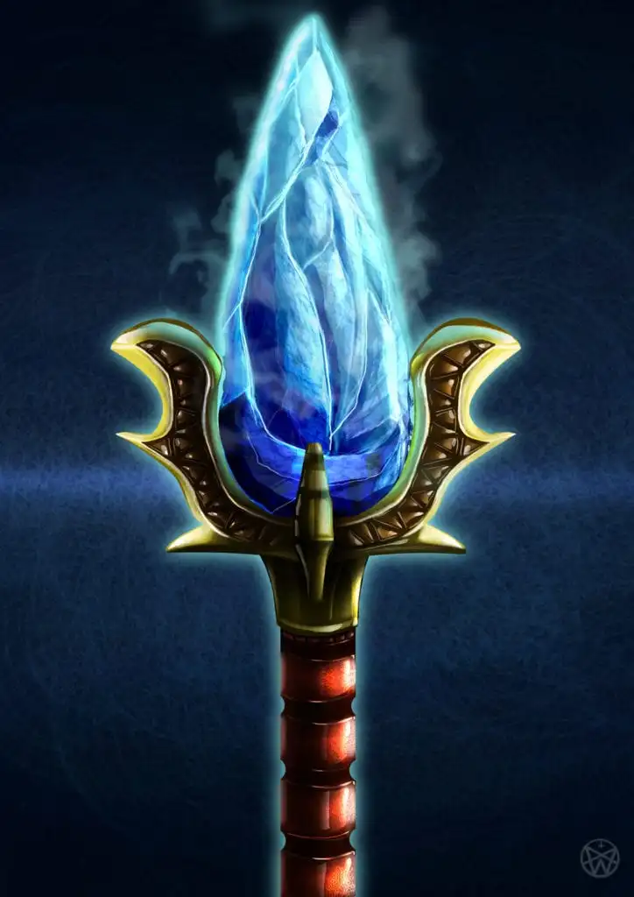

Slide 7
Rubicks life
As the Son of Aghanim he is hunted since a young age
Others might despair of so many murder attempts
Rubick enjoys it and learned from it
after the 8th attempted thought he might have the potential to become magnus
after the 12th attempt he got bored of it.

Slide 8
publicly challenged a Magus
challangening one means to challenge all Maguses
to his surprise they all showed up to fight him
they fought 1 week straight
He defeated them all with their own magic
after this he got the rank of Grand Magus as he was the only one left

Slide 9
